Slide 1



DocuWare (A Document Management System for Gas)
Providing historical scanned mains and service installation records, to office and field crews, in an easy to consume platform-agnostic format, to improve design, operational response time, and safety, using modern digital technology.
23-Aug-2022

Slide 2

Business Problem: The Case for a New Document Management System
Gas services are not always mapped in the Geographic Information System (GIS) in many NG sub-companies:
Services/Detailed Main as-built records are on scanned cards
These records are in the legacy systems such as:
Fortis (NY and MA):
Runs only on Internet Explorer (IE)
Does not run on IOS devices (since IE is not available for IOS)
Field staff running IOS (GBE implementation) do not have access to Scanned Records via Fortis
System runs with great difficulty on Win 10
The product has been deprecated by the vendor
DocuFind (RI)
Is functional limited and cost-prohibitive
Impact To:
Gas Field Force:
No access to configuration of service and location of service valve
Increased risk of incidents and damages due to inability to correctly mark out service locations
Inability to quickly respond to gas damages to make the location safe
Gas Engineers:
Reduced access to service cards for:
New/relay/abandon main design decisions
Large gas outages

Slide 3
Why DocuWare?
A simple easy-to-use / manage Document Management System that:
Is from the same vendor as Fortis:
Business process very similar to that of Fortis
Functionally rich from Day 1
Fully vendor-supported and managed
Cost-effective
Clear migration path from Fortis (6M+ document) to DocuWare
Allows:
Uploading documents and indexing metadata
Quick retrieval of scanned documents
Offline access (if/when needed)
Cloud-hosted and accessible from any National Grid “managed” device (running IOS / Windows / Android)
Runs from any browser
Ability to use the native IOS/Android App
100% configurable to National Grid’s needs
Is scalable as the types of content and the number of records increases, without perceptible degradation of performance
Is lightweight and fast and can run on mobile software with relatively slower network connections
Has the ability to interfaces with the GBE asset management systems (Esri, Maximo, Salesforce, etc.) using an URL

Slide 4
Phased Implementation Approach
FY23
Baseline Conversion from Fortis and Box to DocuWare
FY24
Adding Key Capabilities and Backlog in Fortis/DocuFind
FY24
Integration of DocuWare to GIS, etc.
Phase 1:
RI
Migrate all data from Fortis
Phase 2:
UNY
Migrate all data from Fortis
Phase 3:
LI+NYC
Migrate all data from Fortis
Phase 4:
MA
Phase 0:
ALL
Project Kickoff (Today)
Unified Cross-Jurisdictional Data Model Finalization
Conversion Process Setup
Team Finalization
Migrate delta (post DocuFind Go-Live to DocuWare cutover date) from DocuFind or Paper
Migrate all data from Fortis
ETA for Go-Live by 25-Sep-2020
Completion by 30-Aug-2022
ETA: 15-Mar-2023
ETA: 15-Nov-2022
ETA: 30-Jan-2023
Phase 5:
ALL
Primary Project Close
ETA: 31-Mar-2023

Slide 5
Team Composition
Draft
Gas Business
Matt Breslin Jr (Business Strategist)
IT
Gabriel Regus (Product Owner)
David Wiig (DocuWare)
Alex Solovey (Domain Architect)
Ziad Howlander (Security)
Jeffrey Norwood (Change Management)
Bob Terjesen (Damage Prevention: NY)
James Steadman (E2E Product LeadMichele Rullo )
Andrea Costa (Business Partnering)
Abigail Garcia (Service Owner)
Core Team:
Support Team:
John Carlson (Manager, MA Maps & Records)
Tom Donovan (Manager, NY Maps & Records)
Chris Spurchise (Field Ops-UNY)
Susan Roggi (RI Maps & Records)
Will Nieman (MA Maps & Records)
Xxx (Change Management)
Xxx (CMS)
Xxx (Damage Prevention)
Michelle Roche (Design and Material Processing)
DongNi Qui (Construction/Engineering)
Core Team:
Shraddha Shinde (Fortis Support)
Clinton Joshi (DocuFind Support)
Support Team:
Ryan Ashton (Security Architect)
Travis Coleman (Business Partnering)
Neetu Sahansra (MDM)
Kaizad Patel (Cloud Engineering)
Andrew MacDonald (Firewall/Networking)
Xxx (DNY Maps & Records)
Molly Grzelka (UNY Clerical Support)
Surajit Roy-Chowdhury (Product Director)
Ellen Poyant (E2E Domain Director)
Pratibha Seetharam (Construction)
(Work Support)
Kathleen Finnegan (Work Support)
Ohsafa Harding (Engineering)
Michael Amadi (Engineering)
Mark Huck (Damage Prevention: MA)
Evan Schierwagen (Field Ops-DNY)
Artie / Billie C.. / Kevin Mahoney (Field Ops-MA)
Dennis Ruppert (Corrosion)
Sean Cunningham (Data)
Del Sian (Database Architect)
Kathleen Carr-McCarthy (Data)
Holly Oyer (Clerical Support)
Mahaxxx (QES)

Slide 6
Appendix

Slide 7





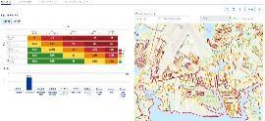
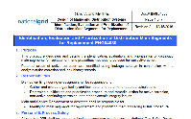
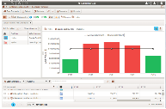





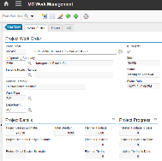
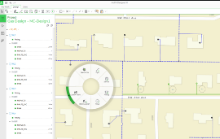
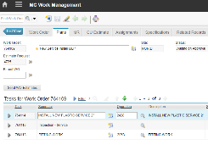
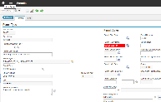



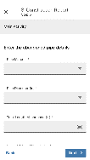
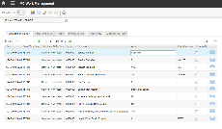

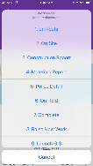
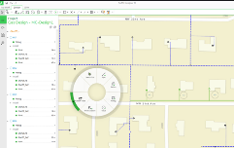
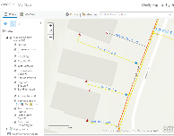
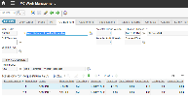
At a Glance:
Replacing High-Risk Pipeline Assets
1
2
3
4
5
Assess asset risk profile
Develop projects based on risk plan
Annual Capital Plan
C55 Investment Creation
C55 Optimization and Investment Selection
A high-level view of how a main replacement program will be initiated, planned, and executed in the future at National Grid.
6
7
8
9
10
Gather permits, DigSafes, & other pre-requisites
Schedule & dispatch work
Initiate project and work orders in Maximo
Design work in GWD
Review / approve work order in Maximo
11
12
13
14
15
Execute work and record completion details in mobile device
Supervisor review of work order in Maximo
Review as-built estimate
Update GIS with asset details
Close financial work order
7

Slide 8


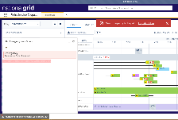
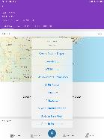





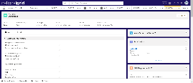
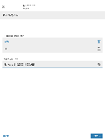
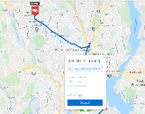

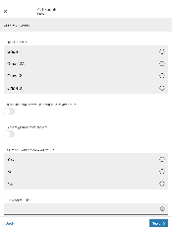
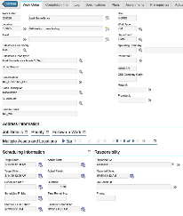
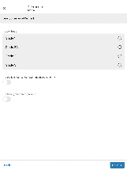
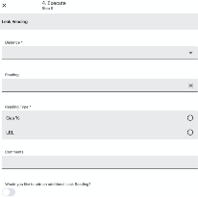


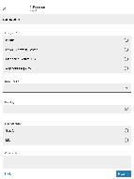
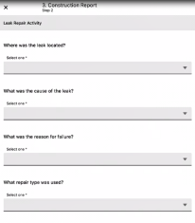
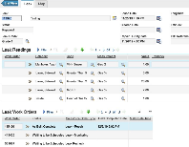


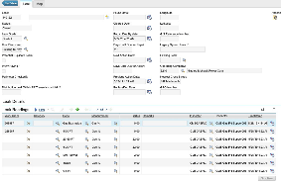

At a Glance:
Responding to an emergency situation
Receive Call and Create the case
Initiate Emergency Response Work Order
Dispatch the work
Assess the situation and make it safe
Capture leak readings and classify the leak
Leak location will be created
Create, Schedule and Dispatch Leak Surveillance and Leak Repair Work
Perform Leak Surveillance Work
Perform Leak Repair work
Update Leak and establish Leak Recheck
Perform Leak Recheck
Close Leak and analyze leak information
1
2
3
4
A high-level view of how National Grid team responds to a Grade 2 gas odor call and restores the operations back to normal
5
6
7
8
9
10
11
12

Slide 10
Business Value Roadmap
Iteration 1:
Iteration 3:
System Configuration (Folders and Metadata)
NG Sample Data Import
Demo
Setup of Sandbox Environment
Iteration 4:
Demo
UI Development: Indexing
UI Development: File Upload
Demo
Iteration 2:
Iteration 5:
Iteration 6:
End-to-End Testing (Initial)
Demo
Iteration 7:
UAT
Iteration 8:
Demo
Iteration 9:
Demo
Iteration 10:
Iteration 16:
Planning for Rollout
Iteration 17:
Service Transition Document Approval
Training Content Development
UI Development: Search and Display
Demo
UI Development: Editing
Demo
Demo
Defect Prioritization
Defect Fixing 1
Defect Fixing 2
UAT
Sign-Off
Demo
Service Transition Document Build
Iteration 18:
RI Delta Sync
RI Rollout
Iteration 20:
LI Delta Sync
LI Rollout
Iteration 21:
NYC Delta Sync
NYC Rollout
Iteration 22:
MA Delta Sync
MA Rollout
Phase 2 (In 1-2 Years):
Migration to Enterprise DMS
Iteration 11:
RI Full Data Conversion
Iteration 13:
LI Full Data Conversion
Iteration 14:
NYC Full Data Conversion
RI Full Data Import
LI Full Data Import
NYC Full Data Import
MA Full Data Conversion
MA Full Data Import
Iteration 15:
Iteration 12:
UNY Full Data Conversion
UNY Full Data Import
Iteration 19:
UNY Delta Sync
UNY Rollout
Iteration 23:
Phase 1 PGLS
Phase 1 Closeout

